Slide 2
AWS & Impetus GenAI Hackathon

Slide 3
Smart Data Synthetic Generator
SynthGen AI
Jeremiah Ope (Full-stack Developer, AI Integration Lead)
Note: All submissions remain the intellectual property of the individuals or organizations that developed them, and go on to describe a non-exclusive, royalty-free license granted to the sponsor, rather than a full transfer of ownership.

Slide 4
Introduction
Team introduction:
Jeremiah Ope – Full-stack Developer & AI Integration Lead
Roles: Built the entire app, integrated Amazon Bedrock, Cognito, and DynamoDB, deployed on Elastic Beanstalk.
Contact information of the team leader:
Email: jeremiahopenetworks@gmail.com
GitHub: github.com/JeremiahOpe

Slide 5
Problem ​statement​
In AI model training, insufficient or sensitive data limits accuracy and usability. Real datasets often lack diversity or require privacy preservation.
Major burden.
Sensitivity
Scaity
Lack of data

Slide 6
Solution approach​
Upload a CSV schema → Generate synthetic data with noise, masking, class balance via AI bedrock Agent.
Auth via Amazon Cognito (guest mode also supported).
Data stored in DynamoDB and downloadable.
Assistant AI explains parameters (noise, PII masking, balance).
Key Features: No-code UI, CSV output, feedback form, AI assistant.
Scaling: Horizontally scalable via Elastic Beanstalk load-balanced architecture.

Slide 7
Tech-stack selection​
Language/Framework: Python (Flask), Bootstrap
AWS Services: Amazon Bedrock, Cognito, DynamoDB, Elastic Beanstalk, IAM
Amazon Titan Text Lite via Amazon Bedrock
Reason: Lightweight, fast to deploy, and deeply integrated with AWS for security and GenAI power.

Slide 8
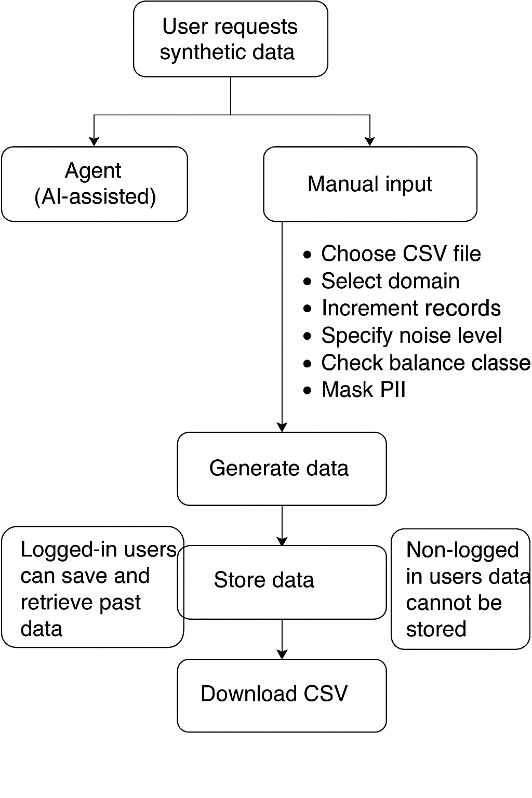
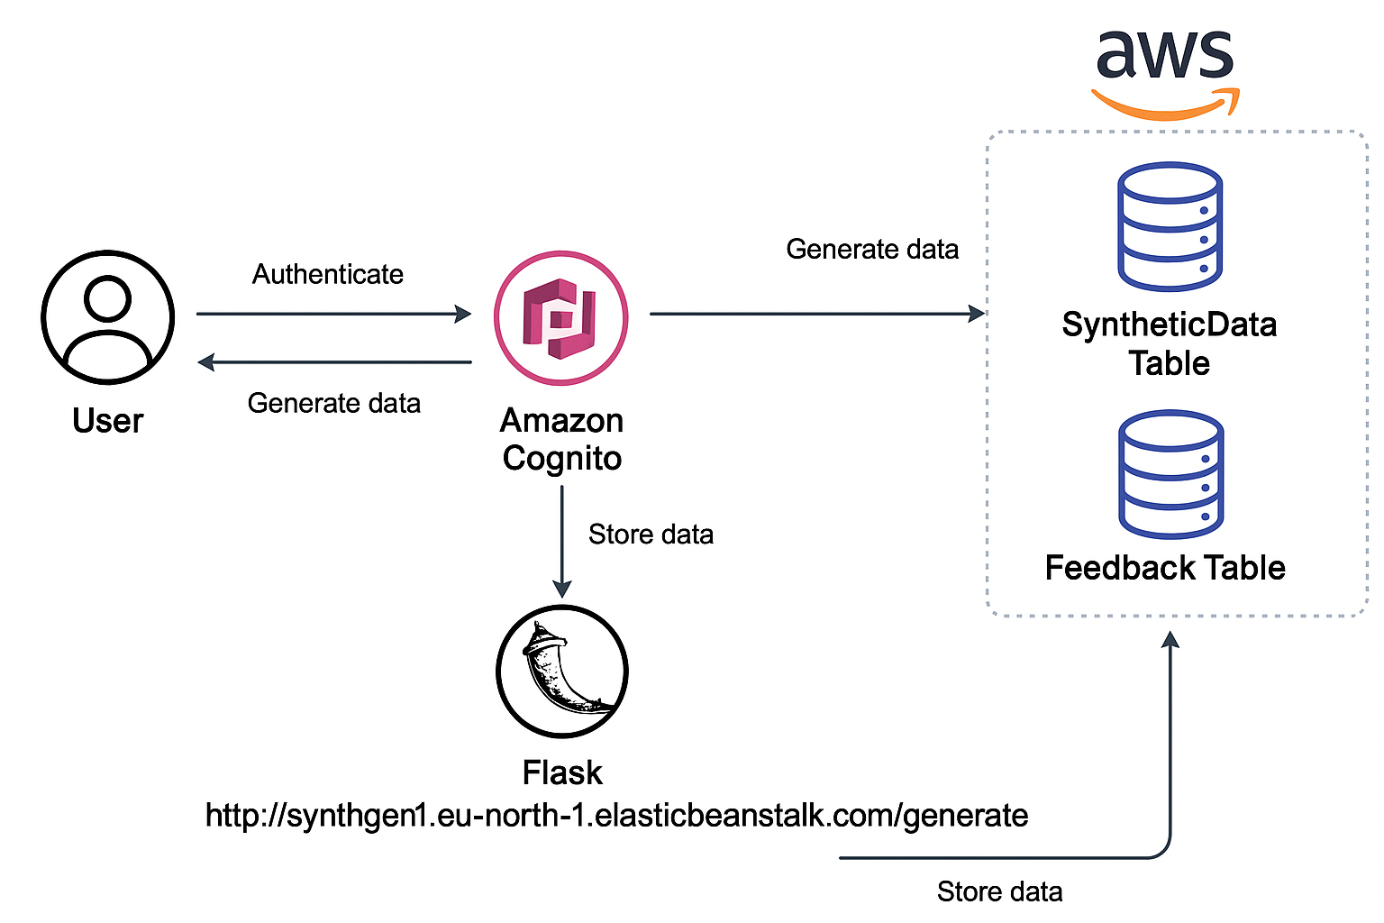
Architecture design/diagram
Architecture design/diagram
Flask app on elastic beanstalk
Amazon Titan Text Lite via Amazon Bedrock
After manual input
Dynamo
DB
Amazon Titan Text Lite via Amazon Bedrock
Architecture diagram
Flowchart diagram

Slide 9
Cost estimates​
Elastic Beanstalk (t3.micro): ~$9/month
Amazon Bedrock usage (Titan Lite): Free tier or ~$0.0012 per 100 characters
DynamoDB: Free tier or ~$1.25/month for light usage
Amazon Cognito: Free tier (first 50k MAUs)
Total: ~$10–15/month for modest usage

Slide 10
Impact potential & limitations​
Impact:
Helps small orgs or students train models without risking PII.
Accessibility
Enables fairer AI via class balancing.
Dependencies:
AWS services, Bedrock API, browser compatibility.
Limitations:
No advanced statistical distribution matching (currently random token generation).
Limited to CSV schema inputs.

Slide 11
Ethical & security considerations​
PII masking helps anonymize data.
Guest mode ensures usability without requiring user data.
OAuth & IAM restricts access to backend APIs.
Data not shared externally.

Slide 12
Project URL, video pitch & demo
Hosted URL: http://synthgen.eu-north-1.elasticbeanstalk.com/generate
GitHub Repo (private): [Link] (grant access to genaihackathon2025@impetus.com, testing@devpost.com)
Demo video link: https://vimeo.com/1100504622?share=copy
Presentation deck: https://docs.google.com/presentation/d/1svYJpYABIDAi4sxN2ZDW_NAeRsveqV2TTIqRN2vPPL8/edit?usp=sharing

